Slide 1

MICROSOFT POWERPOINT

Slide 2
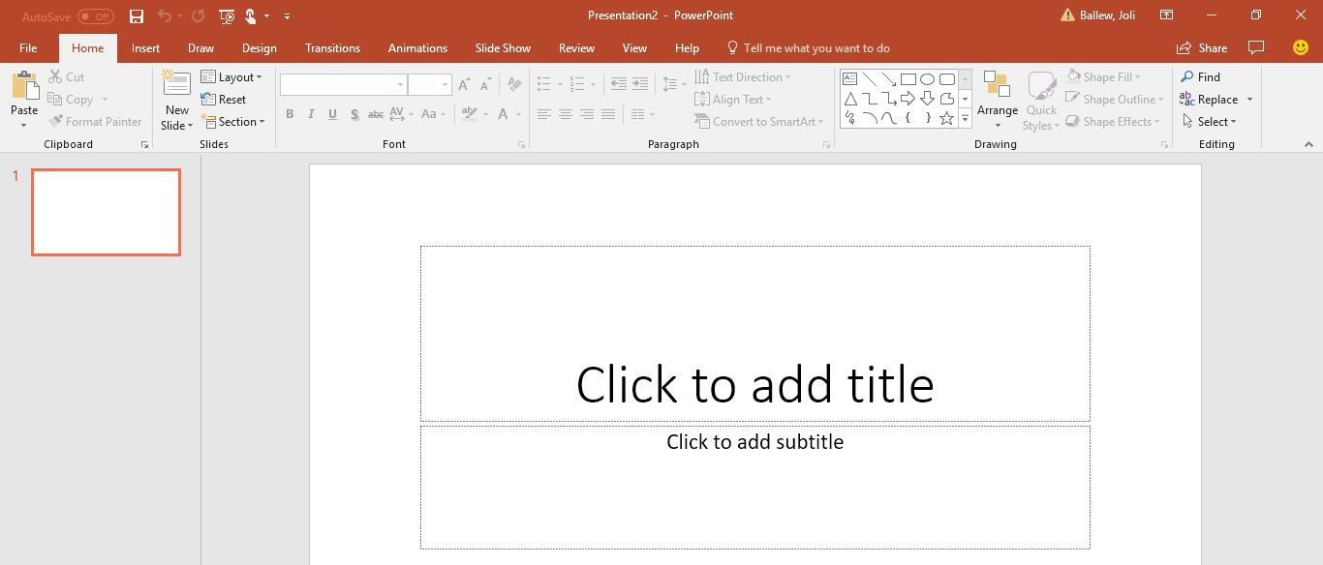
Microsoft PowerPoint is a presentation software used to create slideshows for business, education, and personal use. It helps you design visual presentations using text, images, charts, animations, and videos.

Slide 3
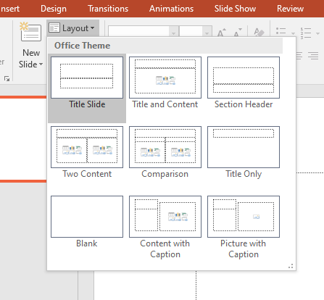
Key Features of Microsoft PowerPoint
Slides and Slide Layouts
A presentation is made up of slides (like pages in a book).
Each slide can have text, images, graphs, or videos.
PowerPoint provides pre-designed layouts to organize
content easily.

Slide 4
Themes and Templates
Choose from built-in themes for a professional look.
Use PowerPoint templates for reports, business presentations, and resumes.
Customize colors, fonts, and backgrounds.

Slide 5
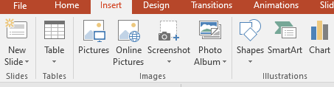
Adding Text and Images
Insert titles, subtitles, and bullet points.
Change font style, size, and color.
Add images, icons, and shapes to make slides visually appealing.

Slide 6
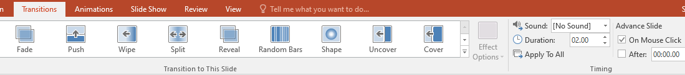
Animations and Transitions
Animations: Apply movement effects to text and images.
Transitions: Add effects between slides (e.g., fade, zoom, slide-in).
Use timing options to control how elements appear.

Slide 7
Inserting Videos, Charts, and SmartArt
Add videos from your computer or YouTube.
Insert charts and graphs to display data.
Use SmartArt for flowcharts and organizational diagrams.

Slide 8
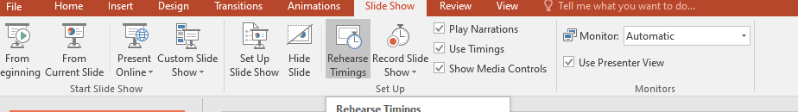
Slide Show Mode
Click Slide Show to present slides full-screen.
Use a laser pointer or pen tool to highlight points.
Set up automatic or manual slide transitions.

Slide 9
Notes and Presenter View
Add speaker notes to help during the presentation.
Use Presenter View to see notes privately while showing slides to the audience.
Collaboration and Sharing
Share presentations via OneDrive or email.
Work with others in real-time on cloud-based versions like PowerPoint Online.

Slide 10
Saving and Exporting Files
Save as .pptx (editable PowerPoint file).
Export as PDF, video (.mp4), or images (.jpg/.png).
Convert slides into handouts for printing.

Slide 11
HOW TO USE IT?
Step 1: Open PowerPoint
Open Microsoft PowerPoint on your computer.
Click New Presentation or choose a Template.
Step 2: Create Slides
Click New Slide to add a slide.
Select a layout (title, content, blank, etc.).

Slide 12
Step 3: Add Content
Click inside text boxes to type text.
Click Insert > Picture to add images.
Click Insert > Video to embed videos.
Step 4: Apply Animations & Transitions
Click Animations to add effects to text/images.
Click Transitions to set slide change effects.

Slide 13
Step 5: Present Your Slideshow
Click Slide Show > From Beginning.
Use arrow keys or a clicker to navigate slides.
Step 6: Save and Share
Click File > Save As to save your work.
Click File > Export to save as PDF or video.

Slide 14
ADVANTAGES
Easy to Use – Simple drag-and-drop interface
Professional Templates – Ready-to-use designs.
Engaging Presentations – Animations, videos, and transitions.
Collaboration – Share and edit with teams.
Multi-Format Support – Save as PPTX, PDF, or MP4 video.

